Slide 1
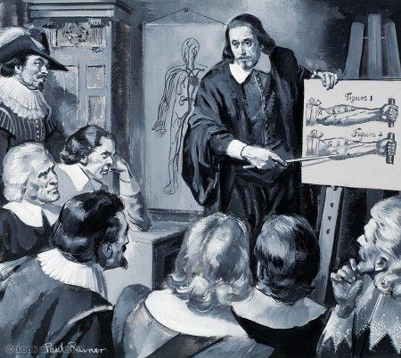
Haemodynamics
William Harvey
1578-1657
Prof. Deepthi de Silva
Department of Physiology

Slide 2
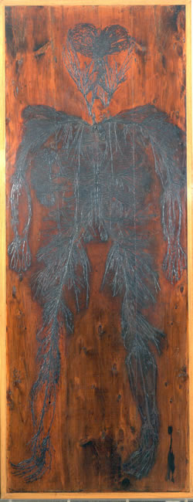
Principles of haemodynamics
Blood flow
Measured as a volume/ unit time (cm³/sec)
Can be measured using electromagnetic or doppler flow meters; plethysmography
(functional studies using fMRI, PET scans)

Slide 3
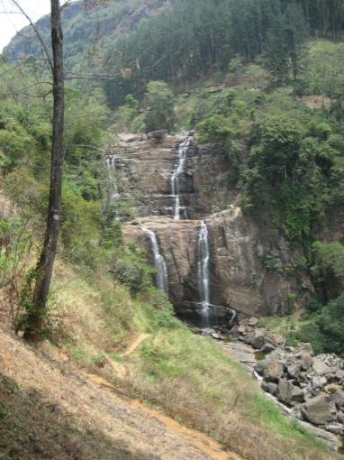
Why does blood flow?
Circulation maintained by a pressure gradient (ΔP)
Heart pumps blood to aorta at a high pressure
Pressure gradually falls in the circulation
  when blood enters the atria, it is at its lowest pressure

Slide 4
Some physics....
Flow (Q) = Pressure gradient (ΔP)
Resistance (R)
Q = (ΔP)/R
Pressure 1
R= Resistance
to flow
Pressure 2
ΔP = P1- P2

Slide 5
In the human body, this means
Q = (ΔP)/R
Pressure (ΔP) = Flow (Q) x Resistance (R)
Blood pressure =
Cardiac output x total peripheral resistance
(BP = CO x TPR)

Slide 6
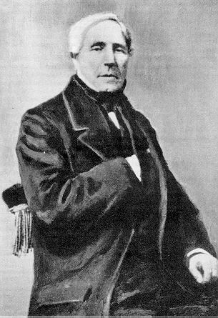
Resistance and blood flow
Resistance ∝ Length of vessel
∝ Viscosity of blood (η)
∝ 1/ radius⁴
Poiseuille formula
Flow = ΔPπr⁴
8ηL
Jean- Louis-Marie
Poiseuille
1799-1869

Slide 7
Significance of the formula
A small change in the radius of a vessel will cause a large change in the flow of blood
  In the body, the arteriolar radius is increased to increase flow
A rise in the haematocrit causes a rise in the viscosity of blood
Also rise in plasma proteins and RBC stiffness

Slide 8
Effects of Viscosity in small vessels
Arterioles, capillaries and venules
RBCs move to centre of vessel
Cell free plasma at the edge of vessel
[Fahraeus-Lindquist effect]
Less viscosity and resistance to flow in these vessels in vivo unless haematocrit very high

Slide 9
Regarding the human circulation
Blood flow is measured using a Doppler flow meter
As the radius of a vessel increases, flow also increases
The main site of resistance in the circulation is in the capillaries
Anaemia is associated with an increase in resistance to flow
A rise in the haematocrit inevitably increases the resistance to flow

Slide 10
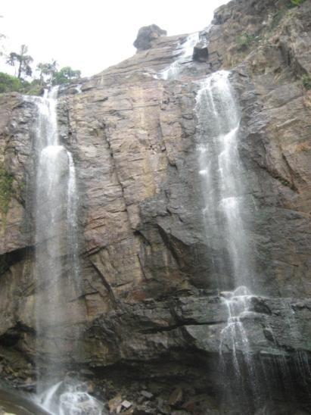
Velocity of blood flow
Flow
  volume per unit time (mL/sec)
  How many Litres go past point A in a second?
Velocity (speed)
  distance per unit time (m/sec)
  How long does it take to go from A to B?
Point A
Point B

Slide 11
Relationship between flow & velocity
What happens in a vessel with a narrowing?
Increased velocity to maintain same volume of flow
Velocity ∝ Flow
∝ 1/Total cross sectional area
  Velocity (V) = Flow (Q) Area (A)

Slide 12
Velocity of flow and cross sectional area
 | Cross sectional area (cm²) | Flow velocity
Aorta | 2.5 | 33cm/sec
Arteries | 20
Arterioles | 40
Capillaries | 2500 | 0.08cm/sec
Venules | 250
Veins | 80
Vena cava | 8

Slide 13
What happens in the body?
Blood flows from the aorta to capillaries
Total cross sectional area very high in capillaries
Velocity falls from the aorta (30cm/sec) to the capillary (0.08cm/sec)
Gives time for exchange of gases, nutrients, fluids, electrolytes at capillaries

Slide 14
Regarding blood flow
The velocity of flow is measured in metres/sec
The flow is increased as the velocity increases
As the total area of a vessel decreases, the velocity increases
In the human circulation, the largest cross sectional area is in the aorta
The highest velocity of flow is recorded in capillaries

Slide 15
Blood flow
Laminar flow
Close to vessel wall, hardly any movement
Highest velocity in the middle of vessel
Efficient flow
Vessels >0.5mm
Turbulent flow
Movement in all directions
Increases resistance to flow
Larger ΔP to move blood

Slide 16
Assessing turbulence
Reynold’s number (Re)
  Turbulence associated >2000
In life, turbulence causes sounds that can be auscultated (using stethoscope)
  Murmurs (and thrills) in heart
  Bruits (vessels)
Re = ρdv
η
= Density of liquid
d = Vessel diameter
V = Velocity
η = Viscosity
Why are murmurs heard in anaemia?

Slide 17
Law of Laplace
Tension of wall (T) = Transmural Pressure (P) x Radius (r)
Thickness (w)
T
PPP
T = P x r
w
P
Prevents small vessels (e.g. Capillaries)
from collapsing

Slide 18
Critical closing pressure
In small vessels, the surrounding tissue pressure > pressure inside the vessel
  Causes collapse of vessel with no flow
Happens in inactive tissue capillaries
  e.g. Muscles at rest

Slide 19
Regarding flow of blood
Laminar flow causes bruits in blood vessels
The risk of turbulence is measured by the Reynold’s number
Increase in velocity of flow is associated with turbulent flow
A fall in the haematocrit causes cardiac murmurs
The risk of a vessel rupture is higher in smaller than larger vessels according to the law of Laplace

